Slide 1

ICBP 2.0 KT
Day 2
Implementing a Simple GAN with MNIST

Slide 2
Agenda
Implementing a Simple GAN with MNIST
Recap Simple GAN Architecture
Understand the MNIST
Implementation
Import libraries
Load and preprocess MNIST
Define Generator and Discriminator models
Define loss functions and optimizers
Training loop (alternate training between G and D)
Generate and visualize output
DCGANs (Deep Convolutional GANs)
Why Transition to DCGANs?
DCGAN Architecture Overview
Principles of DCGANs
Comparing Simple GAN vs DCGAN
DCGAN Implementation
Import libraries and data (MNIST/CIFAR-10)
Preprocess data to [-1, 1] range
Define DCGAN Generator (ConvTranspose2D stack)
Define DCGAN Discriminator (Conv2D stack)
Losses and optimizers
Training loop with sample visualization
Notes:
Here we are going to learn,
Text classification involves assigning categories to text, commonly applied in spam detection. It requires preprocessing (tokenization, stopword removal) and vectorization (e.g., TF-IDF). Models like Naive Bayes or Logistic Regression are trained and evaluated using metrics like accuracy and F1-score.

Slide 3
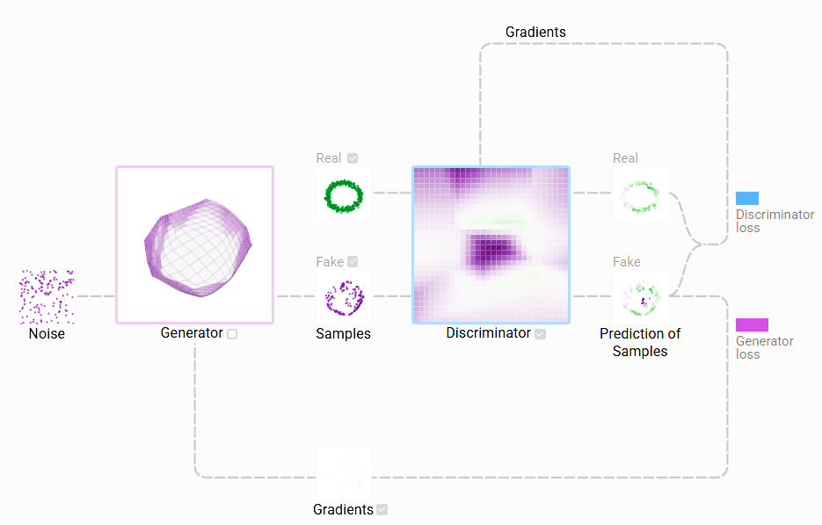
Implementing a Simple GAN with MNIST
Recap Simple GAN Architecture

Slide 4
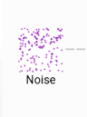
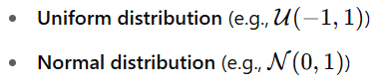
Implementing a Simple GAN with MNIST
Recap Simple GAN Architecture
"Noise" in GANs:
Noise refers to a random vector z, usually sampled from a simple distribution like:
This noise vector serves as the input to the generator.

Slide 5
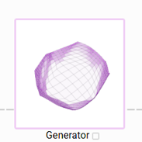
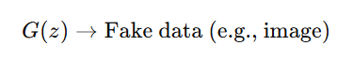
Implementing a Simple GAN with MNIST
Recap Simple GAN Architecture
Generator
The generator (G) is a neural network that takes as input a random noise vector zzz (usually from a normal or uniform distribution) and outputs fake data (e.g., images, text, audio).
The generator is trained to fool the discriminator into thinking the fake data is real. It improves by receiving gradient feedback from the discriminator’s classification of its output.

Slide 6
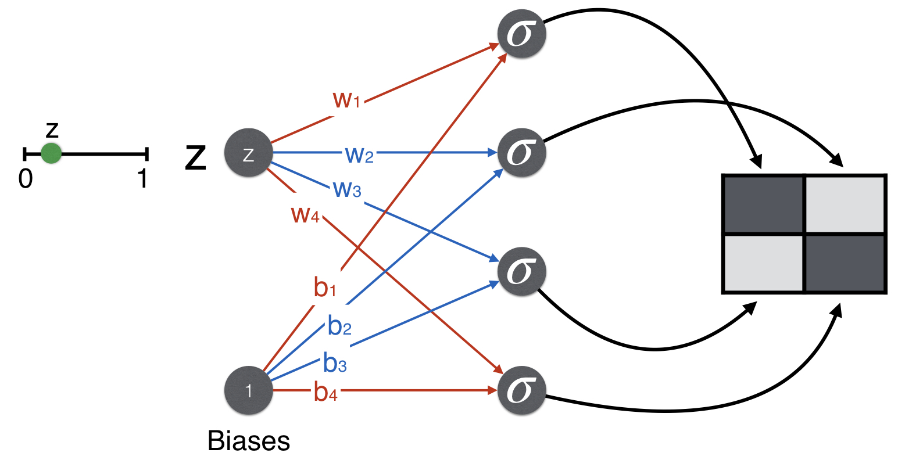
Implementing a Simple GAN with MNIST
Recap Simple GAN Architecture
Generator

Slide 7
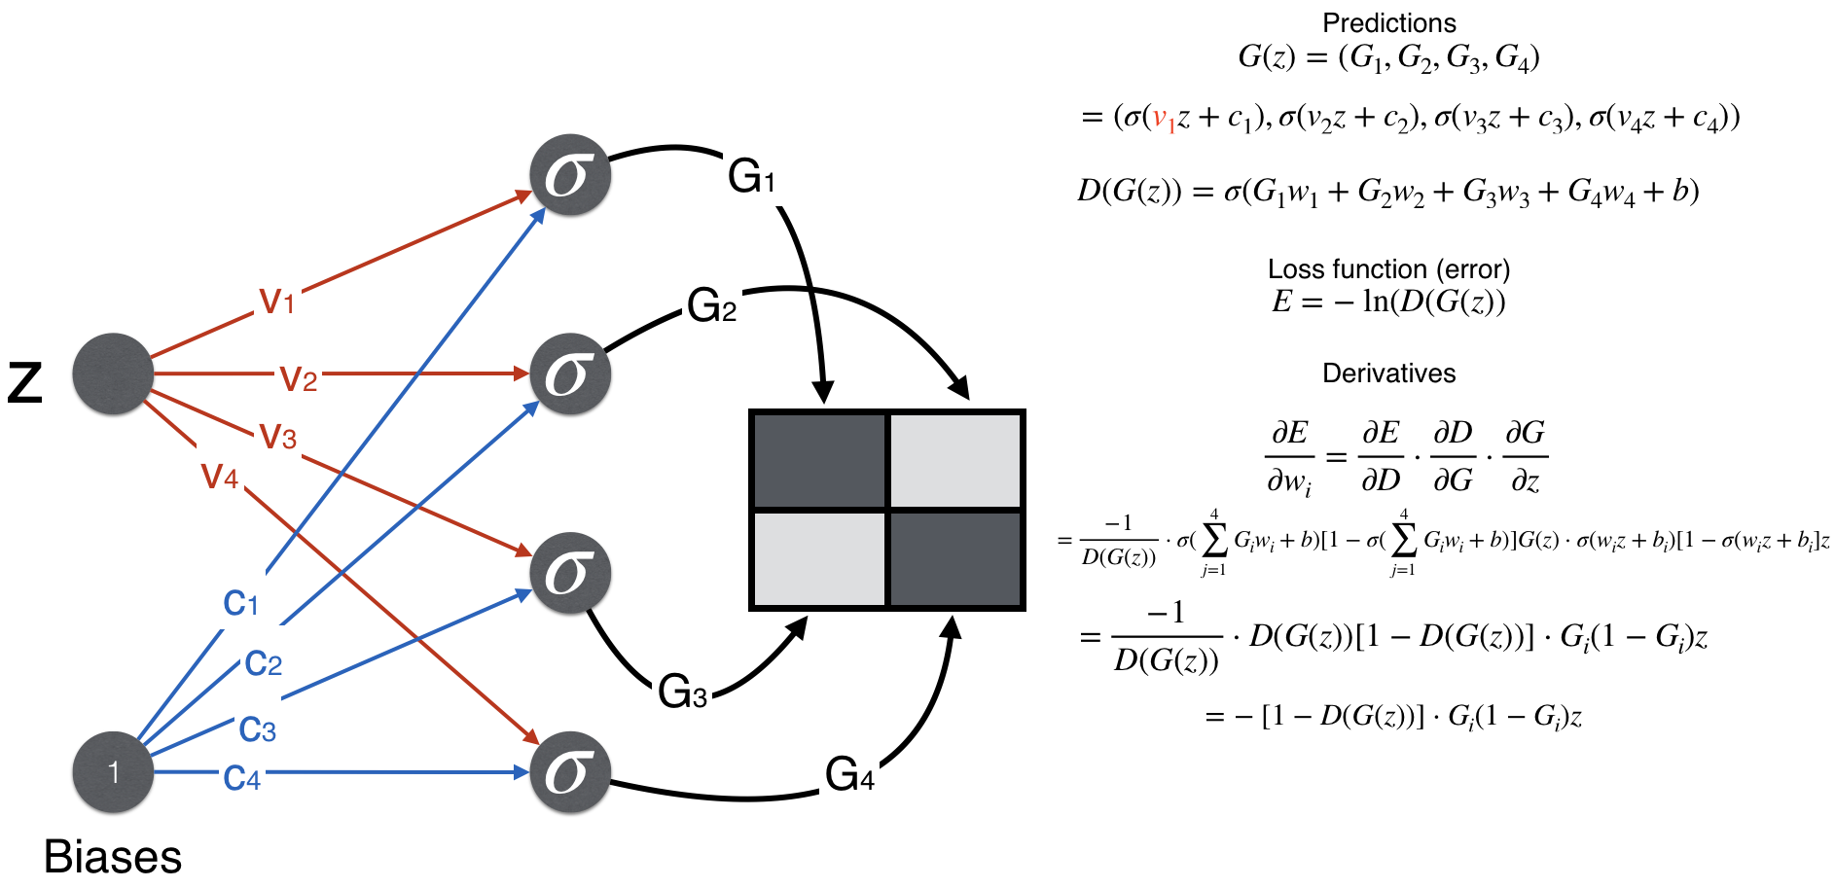
Implementing a Simple GAN with MNIST
Recap Simple GAN Architecture
Generator

Slide 8
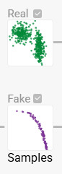
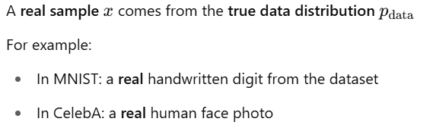
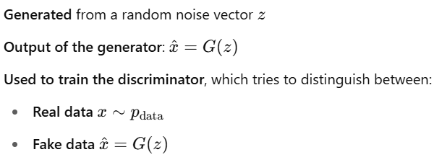
Implementing a Simple GAN with MNIST
Recap Simple GAN Architecture
Real
Samples

Slide 9
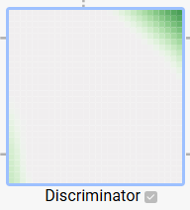
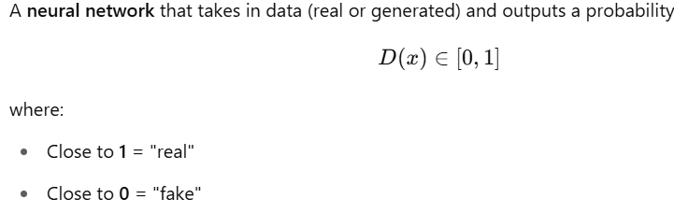
Implementing a Simple GAN with MNIST
Recap Simple GAN Architecture
Discriminator
The discriminator is the model that acts like a binary classifier, distinguishing between real and fake samples.

Slide 10
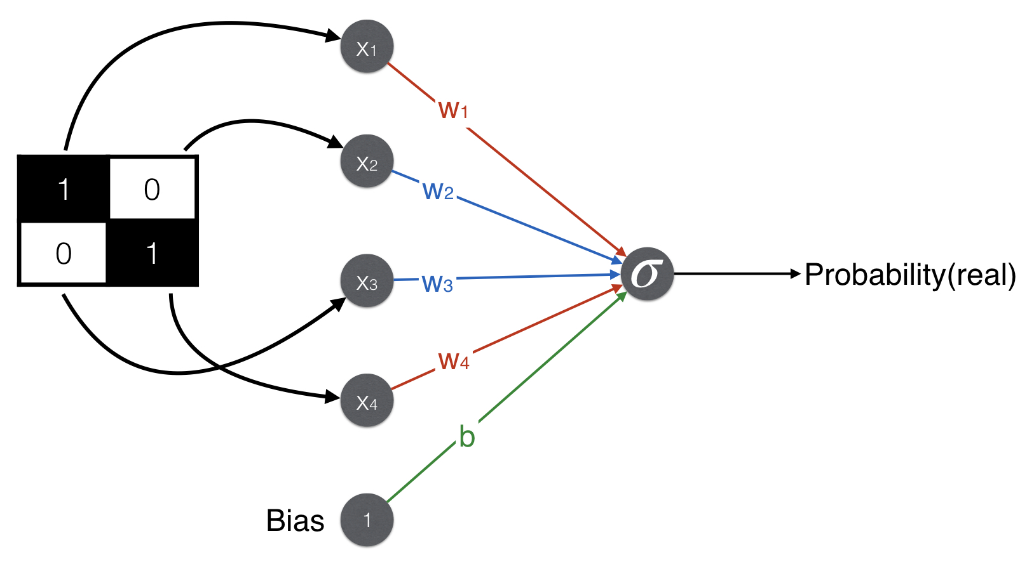
Implementing a Simple GAN with MNIST
Recap Simple GAN Architecture
Discriminator

Slide 11
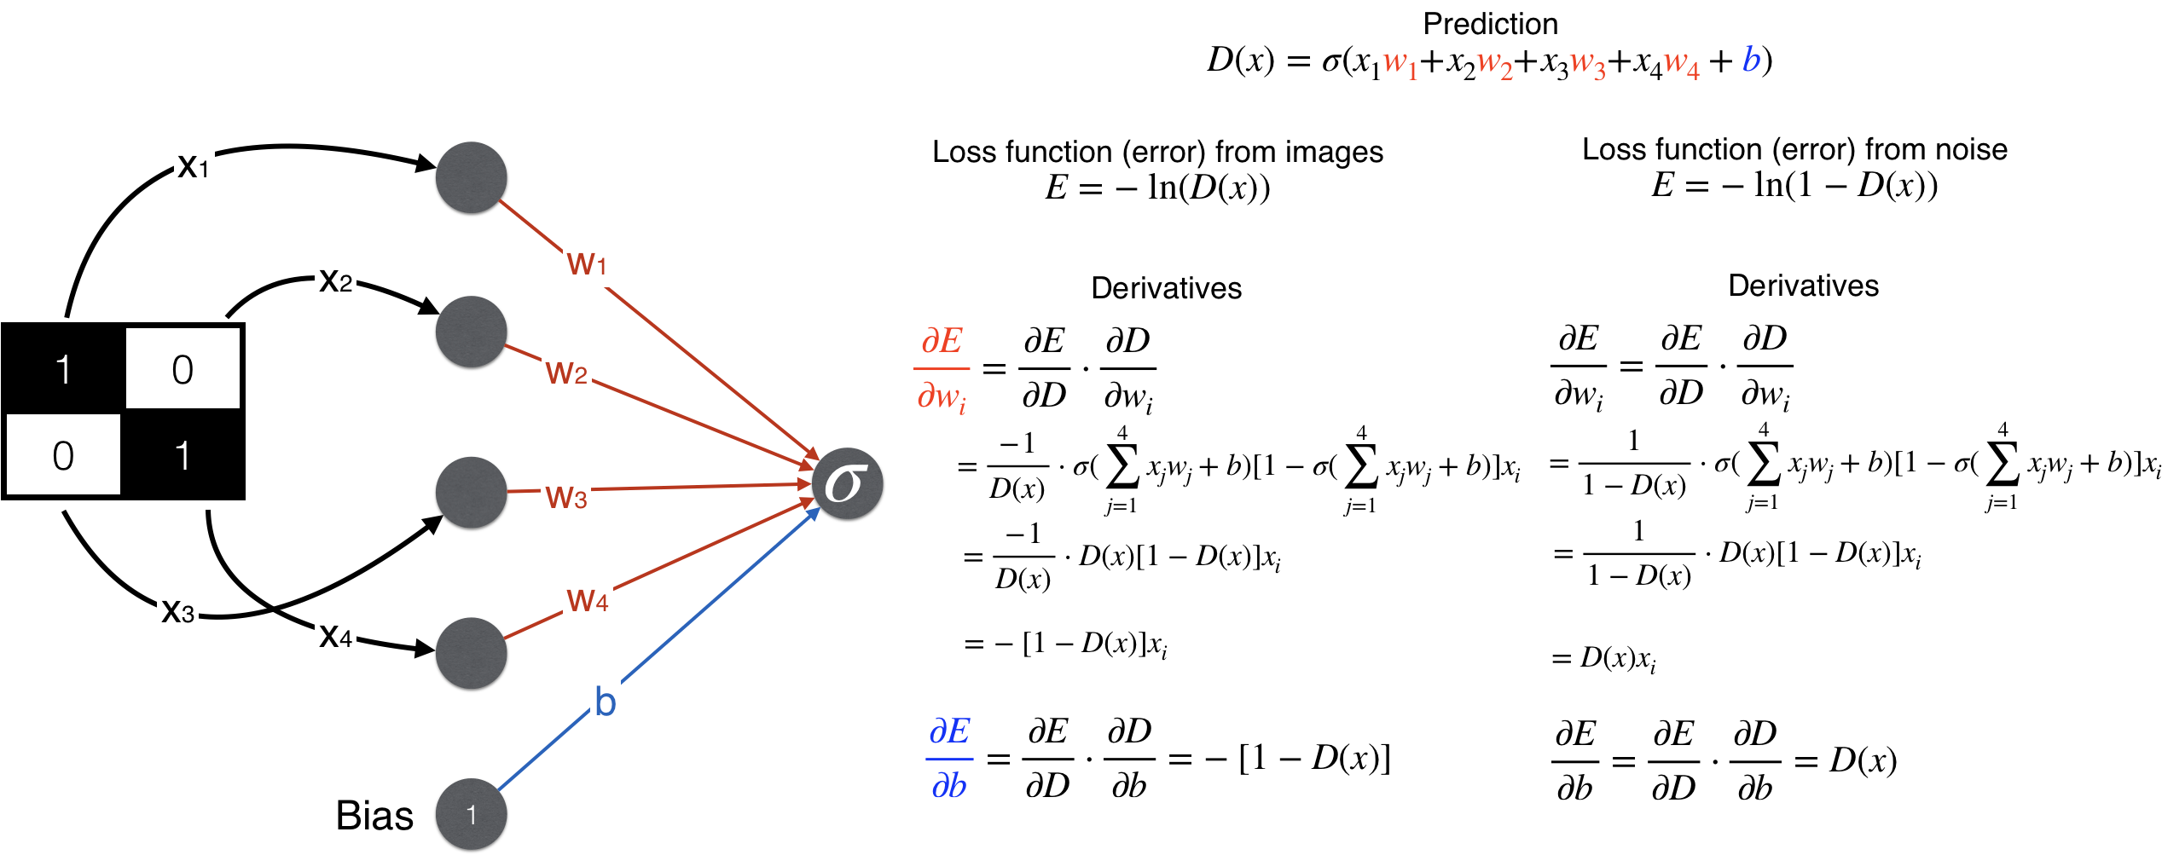
Implementing a Simple GAN with MNIST
Recap Simple GAN Architecture
Discriminator

Slide 12
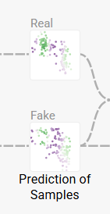
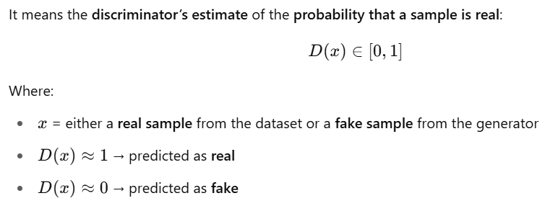
Implementing a Simple GAN with MNIST
Recap Simple GAN Architecture
Prediction of Samples
The prediction of samples refers to the discriminator’s output, which judges whether each sample—real or fake—is likely to come from the true data distribution.
After the discriminator processes both real and fake (prediction) samples, it outputs a probability score for each—indicating how real it believes the sample is.

Slide 13
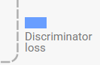
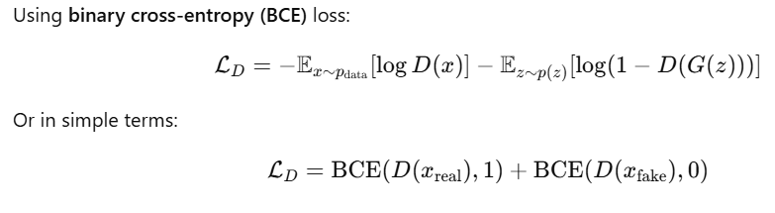
Implementing a Simple GAN with MNIST
Recap Simple GAN Architecture
Discriminator loss
The discriminator loss measures how well the discriminator can tell real samples from fake ones. It’s a key part of training because it provides feedback that helps both the discriminator and the generator improve.
The discriminator aims to:
Maximize the probability of correctly classifying real samples as real
Minimize the probability of misclassifying fake samples as real
Discriminator Loss Formula

Slide 14
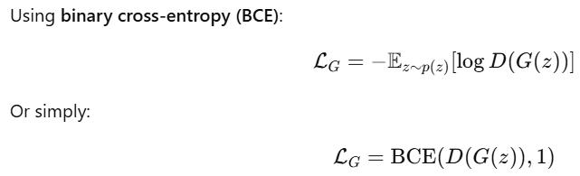
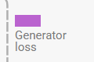
Implementing a Simple GAN with MNIST
Recap Simple GAN Architecture
Generator loss
The generator loss measures how well the generator is doing at fooling the discriminator. Its goal is to generate data so realistic that the discriminator classifies it as real.
the generator is trying to maximize the discriminator’s mistake—it wants D(G(z)) to be high, as if the fake is real. So during generator training, fake samples are labeled as real (1).

Slide 15
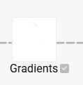
Implementing a Simple GAN with MNIST
Recap Simple GAN Architecture
Gradients
The gradients are the signals used to update the weights of both the generator and the discriminator during training. These gradients come from the loss functions and are propagated backward through the networks via backpropagation.
How much its output differs from the target
Which direction to adjust its weights to reduce loss

Slide 16
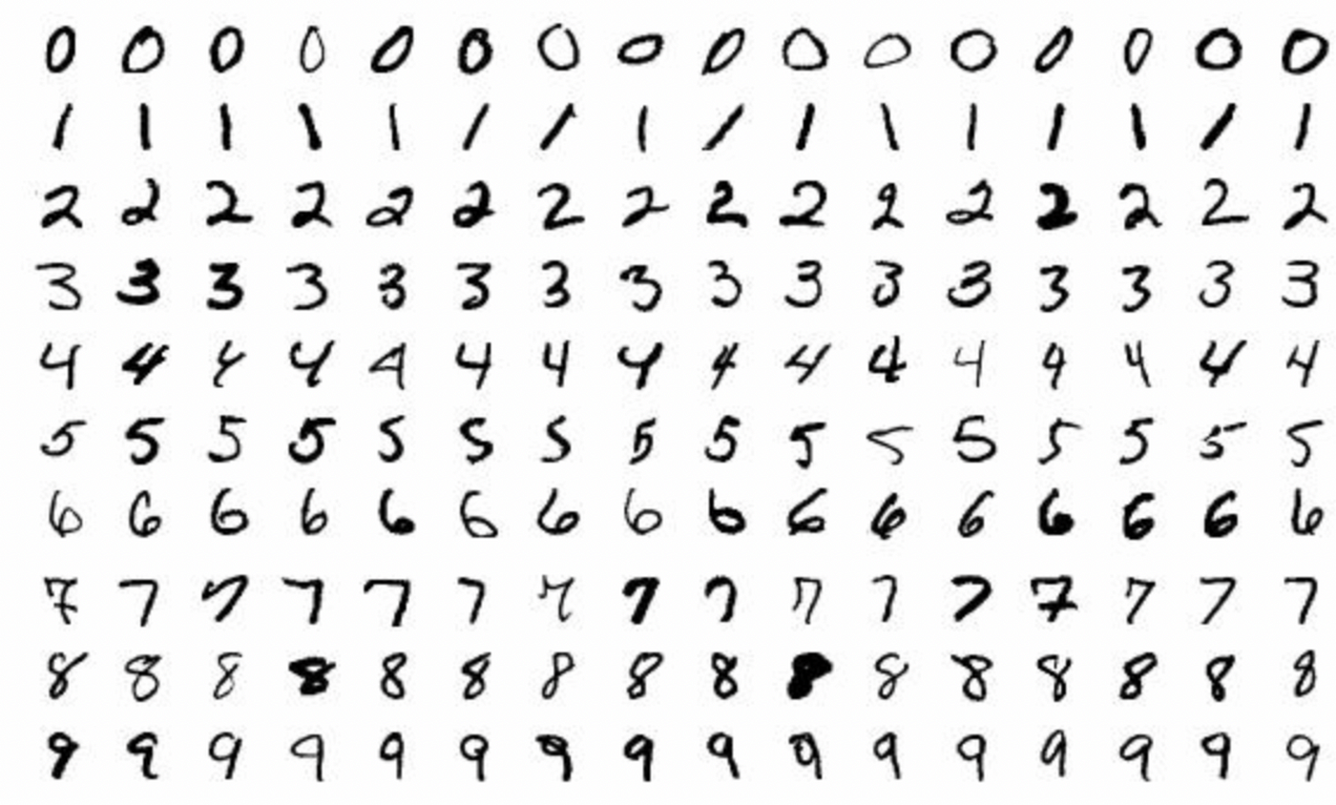
Implementing a Simple GAN with MNIST
Understand the MNIST
The MNIST dataset consists of 28x28 grayscale images of handwritten digits (0-9), with 60,000 images in the training set and 10,000 in the test set. The images are normalized to a range between -1 and 1 during preprocessing, which is standard when training GANs to ensure stable gradients.

Slide 17
Implementing a Simple GAN with MNIST
Implementation
Import libraries
Load and preprocess MNIST
Define Generator and Discriminator models
Define loss functions and optimizers
Training loop (alternate training between G and D)
Generate and visualize output

Slide 18
ICBP 2.0 KT
Day 3
Transitioning to DCGANs

Slide 19
Agenda
Implementing a Simple GAN with MNIST
Recap Simple GAN Architecture
Understand the MNIST
Implementation
Import libraries
Load and preprocess MNIST
Define Generator and Discriminator models
Define loss functions and optimizers
Training loop (alternate training between G and D)
Generate and visualize output
DCGANs (Deep Convolutional GANs)
Why Transition to DCGANs?
DCGAN Architecture Overview
Principles of DCGANs
Comparing Simple GAN vs DCGAN
DCGAN Implementation
Import libraries and data (MNIST/CIFAR-10)
Preprocess data to [-1, 1] range
Define DCGAN Generator (ConvTranspose2D stack)
Define DCGAN Discriminator (Conv2D stack)
Losses and optimizers
Training loop with sample visualization
Notes:
Here we are going to learn,
Text classification involves assigning categories to text, commonly applied in spam detection. It requires preprocessing (tokenization, stopword removal) and vectorization (e.g., TF-IDF). Models like Naive Bayes or Logistic Regression are trained and evaluated using metrics like accuracy and F1-score.

Slide 20
DCGANs (Deep Convolutional GANs)
Why Transition to DCGANs?
1. Improved Image Quality
Traditional GANs (with fully connected layers) don’t handle image data well.
DCGANs use convolutional layers, which are better suited for capturing spatial hierarchies in images, leading to sharper, more realistic results.
2. Better Architectural Guidance
The original DCGAN paper provided practical architectural rules that made GANs more stable and trainable.
Use of strided convolutions instead of pooling
Batch normalization for both generator and discriminator
LeakyReLU in discriminator and ReLU in generator

Slide 21
DCGANs (Deep Convolutional GANs)
Why Transition to DCGANs?
1. Improved Image Quality
Traditional GANs (with fully connected layers) don’t handle image data well.
DCGANs use convolutional layers, which are better suited for capturing spatial hierarchies in images, leading to sharper, more realistic results.
2. Better Architectural Guidance
The original DCGAN paper provided practical architectural rules that made GANs more stable and trainable.
Use of strided convolutions instead of pooling
Batch normalization for both generator and discriminator
LeakyReLU in discriminator and ReLU in generator

Slide 22
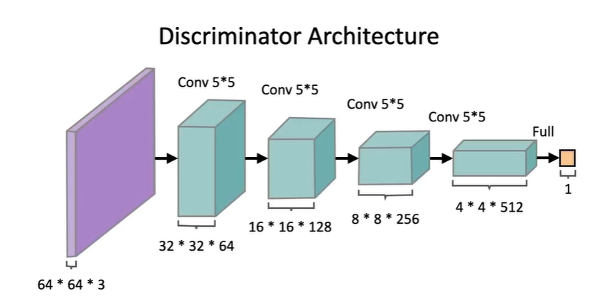
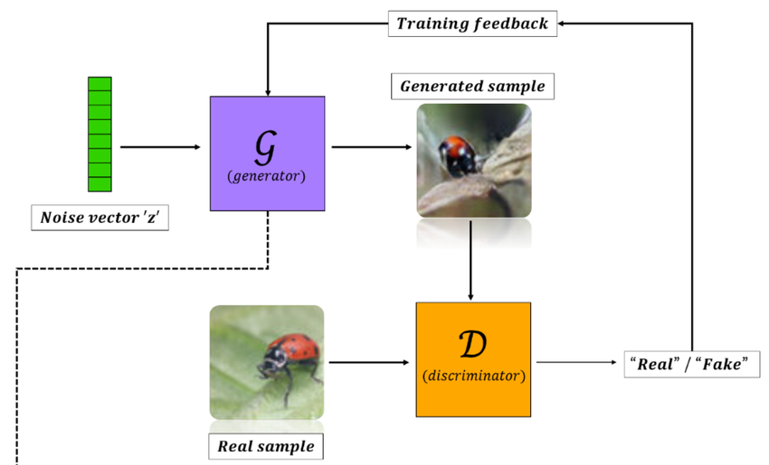
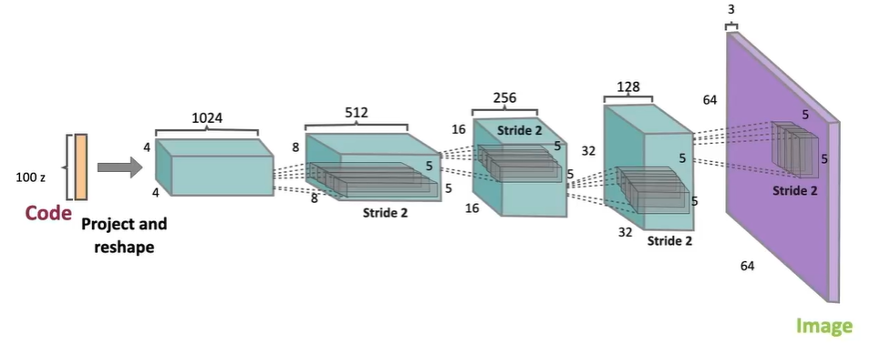
DCGANs (Deep Convolutional GANs)
DCGAN Architecture Overview

Slide 23
DCGANs (Deep Convolutional GANs)
Principles of DCGANs
The principles of DCGANs (Deep Convolutional GANs) are a set of design guidelines and best practices introduced in the original DCGAN paper (Radford et al., 2015) to improve GAN training stability and image quality using convolutional networks.
Replace Pooling Layers with Strided Convolutions
Use Batch Normalization in Both Networks
Use ReLU Activation in Generator (except output layer)
Use LeakyReLU Activation in Discriminator
Remove Fully Connected Layers in Deeper Networks
Normalize Image Inputs Between -1 and 1

Slide 24
DCGANs (Deep Convolutional GANs)
Comparing Simple GAN vs DCGAN
Feature | Simple GAN | DCGAN (Deep Convolutional GAN)
Architecture | Fully connected (dense) layers | Deep convolutional layers
Input Type | 1D vector flattened images | 2D images (preserving spatial structure)
Generator Layers | Dense → Dense → Dense → Output | ConvTranspose2d → BatchNorm → ReLU → Tanh
Discriminator Layers | Dense → Dense → Dense → Output | Conv2d → BatchNorm → LeakyReLU → Sigmoid
Activation Functions | ReLU or Sigmoid | ReLU (G), LeakyReLU (D), Tanh (G output), Sigmoid (D output)
Image Quality | Blurry, low-quality, lacks spatial consistency | Sharper, more realistic, preserves spatial details
Training Stability | More prone to instability and mode collapse | More stable with proper design
Batch Normalization | Not typically used | Used in most layers (except input/output)
Use Case | Educational or basic generative tasks | Image synthesis, transfer learning, deep features
Scalability | Hard to scale to high-res images | Scales better with image size

Slide 25
ICBP 2.0 KT
Day 4
Train Conditional Generative Adversarial Network

Slide 26
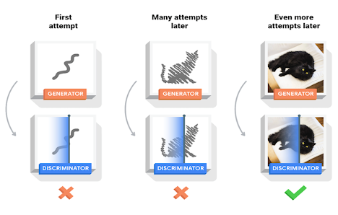
Agenda
What is Conditional GAN?
Architecture and Working of cGANs
Use-cases
Implementing cGAN
Dataset Preparation
Model Architecture
Discriminator
Training Loop Overview
Evaluation

Slide 27
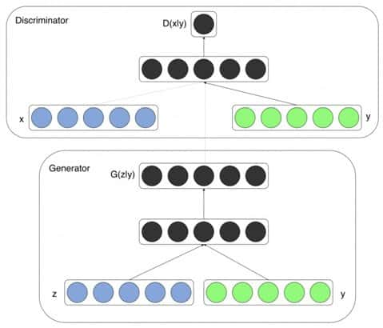
Conditional GAN
What is Conditional GAN?
If you want to generate only BMW cars from a dataset of various cars CGANs allow you to specify “BMW" as a condition. The generation of data in a CGAN is conditional on specific input information which could be labels, class information or any other relevant features. This conditioning enables more precise and targeted data generation.

Slide 28
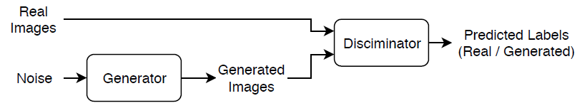
Conditional GAN
A GAN consists of two networks that train together:
Generator — Given a vector of random values as input, this network generates data with the same structure as the training data.
Discriminator — Given batches of data containing observations from both the training data, and generated data from the generator, this network attempts to classify the observations as "real" or "generated".

Slide 29
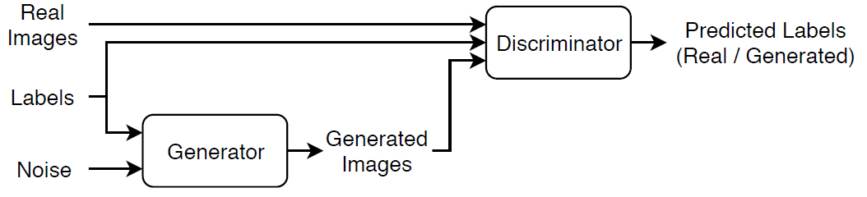
Conditional GAN
A conditional generative adversarial network (CGAN) :
Generator — Given a label and random array as input, this network generates data with the same structure as the training data observations corresponding to the same label.
Discriminator — Given batches of labeled data containing observations from both the training data and generated data from the generator, this network attempts to classify the observations as "real" or "generated".

Slide 30
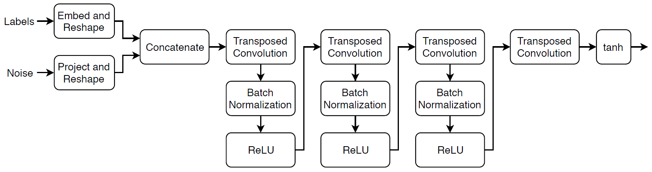
Conditional GAN
Define Generator Network
Notes:
This network:
Converts the random vectors of size 100 to 4-by-4-by-1024 arrays using a fully connected layer followed by a reshape operation.
Converts the categorical labels to embedding vectors and reshapes them to a 4-by-4 array.
Concatenates the resulting images from the two inputs along the channel dimension. The output is a 4-by-4-by-1025 array.
Upscales the resulting arrays to 64-by-64-by-3 arrays using a series of transposed convolution layers with batch normalization and ReLU layers.
Define this network architecture and specify the following network properties.
For the categorical inputs, use an embedding dimension of 50.
For the transposed convolution layers, specify 5-by-5 filters with a decreasing number of filters for each layer, a stride of 2, and "same" cropping of the output.
For the final transposed convolution layer, specify a three 5-by-5 filter corresponding to the three RGB channels of the generated images.
At the end of the network, include a tanh layer.
To project and reshape the noise input, use a fully connected layer followed by a reshape operation specified as a function layer with function given by the feature2image function, attached to this example as a supporting file. To embed the categorical labels, use the custom layer embeddingLayer attached to this example as a supporting file. To access these supporting files, open the example as a live script.

Slide 31
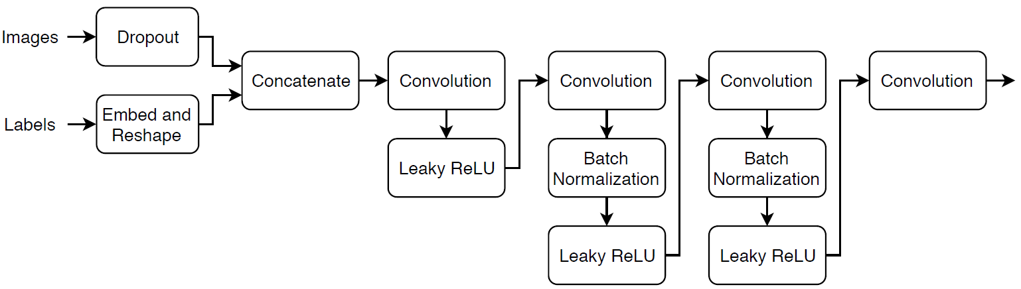
Conditional GAN
Define Discriminator Network
Notes:
Create a network that takes as input 64-by-64-by-1 images and the corresponding labels and outputs a scalar prediction score using a series of convolution layers with batch normalization and leaky ReLU layers. Add noise to the input images using dropout.
For the dropout layer, specify a dropout probability of 0.75.
For the convolution layers, specify 5-by-5 filters with an increasing number of filters for each layer. Also specify a stride of 2 and padding of the output on each edge.
For the leaky ReLU layers, specify a scale of 0.2.
For the final layer, specify a convolution layer with one 4-by-4 filter.

Slide 32
Conditional GAN
Use-cases
Image Generation: cGANs are widely used in generating images based on specific attributes, such as creating realistic images of faces conditioned on gender or age.
Text-to-Image Synthesis: In this application, cGANs can generate images from textual descriptions, bridging the gap between natural language processing and computer vision.
Video Generation: cGANs can also be applied to generate video frames conditioned on previous frames or specific actions, facilitating the development of realistic video simulations.
Medical Image Synthesis: In healthcare, cGANs can generate medical images (e.g., MRI scans) conditioned on specific diagnoses or features, assisting in training diagnostic models and enhancing the understanding of various conditions.

Slide 33
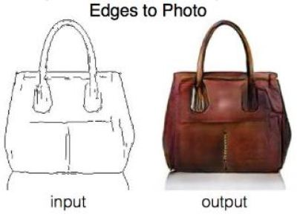
Conditional GAN
Implementing cGAN
Dataset Preparation
Model Architecture
Discriminator
Training Loop Overview
Evaluation

Slide 34
ICBP 2.0 KT
Day 5
Retrieval-Augmented Generation (RAG)

Slide 35

Retrieval-Augmented Generation (RAG)
Content
Introduction & Motivation
Setup & Tools
Document Indexing (Retriever Setup)
RAG Pipeline (Retriever + Generator)
Implementation of Retrieval-Augmented Generation (RAG)

Slide 36
Retrieval-Augmented Generation (RAG)
What is RAG?
RAG models enhance generative models (like GPT or BART) by allowing them to access external documents (such as Wikipedia articles or company knowledge bases) during inference. This allows the model to “look things up” rather than relying solely on memorized training data.
RAG (Retrieval-Augmented Generation) is a hybrid NLP model that combines:
Retrieval-based methods: Fetch relevant documents from an external knowledge base
Generative models: Generate natural language responses using the retrieved content
It was introduced by Facebook AI in 2020 as a way to improve factual correctness and scale language models to large knowledge domains.

Slide 37
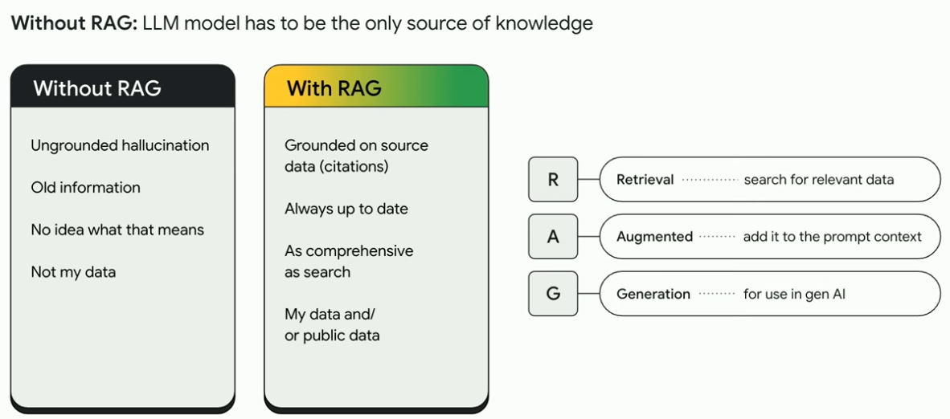
Retrieval-Augmented Generation (RAG)
RAG Understanding

Slide 38
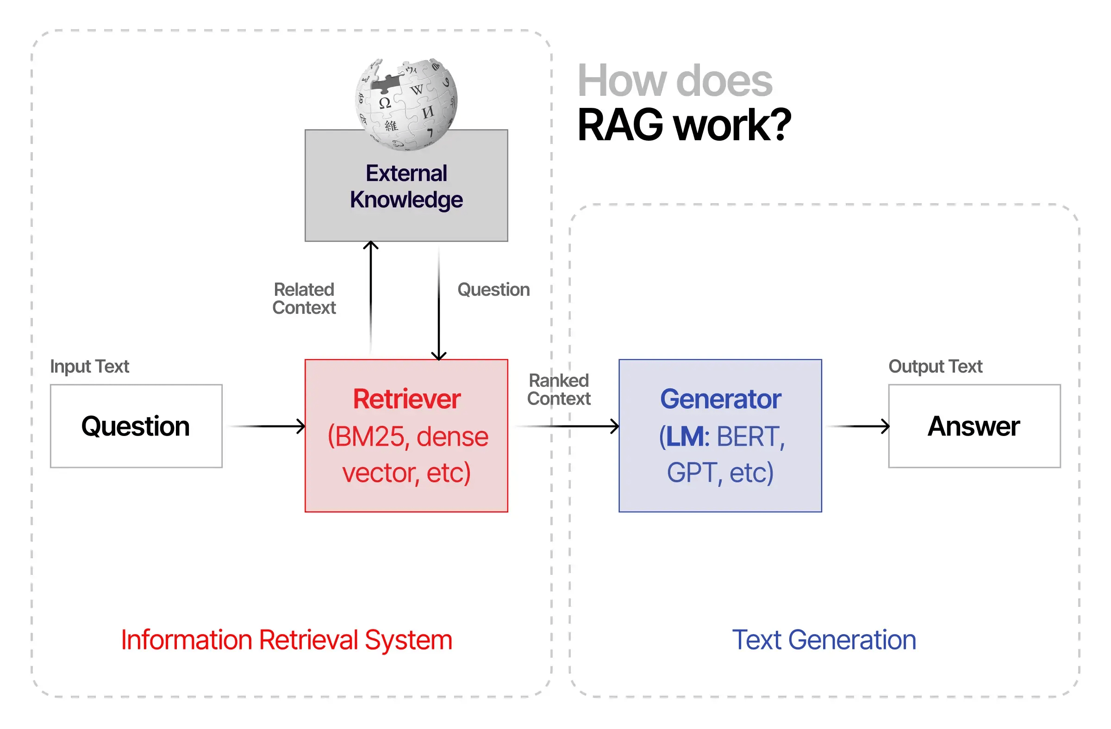
Retrieval-Augmented Generation (RAG)
How RAG Work?

Slide 39
Retrieval-Augmented Generation (RAG)
Setup & Tools
Transformers - To use pre-trained encoders like DPRQuestionEncoder and DPRContextEncoder from Hugging Face.
Datasets - To load, manipulate, and process large text corpora (e.g., Wikipedia, Natural Questions) efficiently.
faiss-cpu - To perform efficient similarity search over millions of dense passage embeddings.
Torch - All Hugging Face models (including DPR) are built on PyTorch by default.

Slide 40
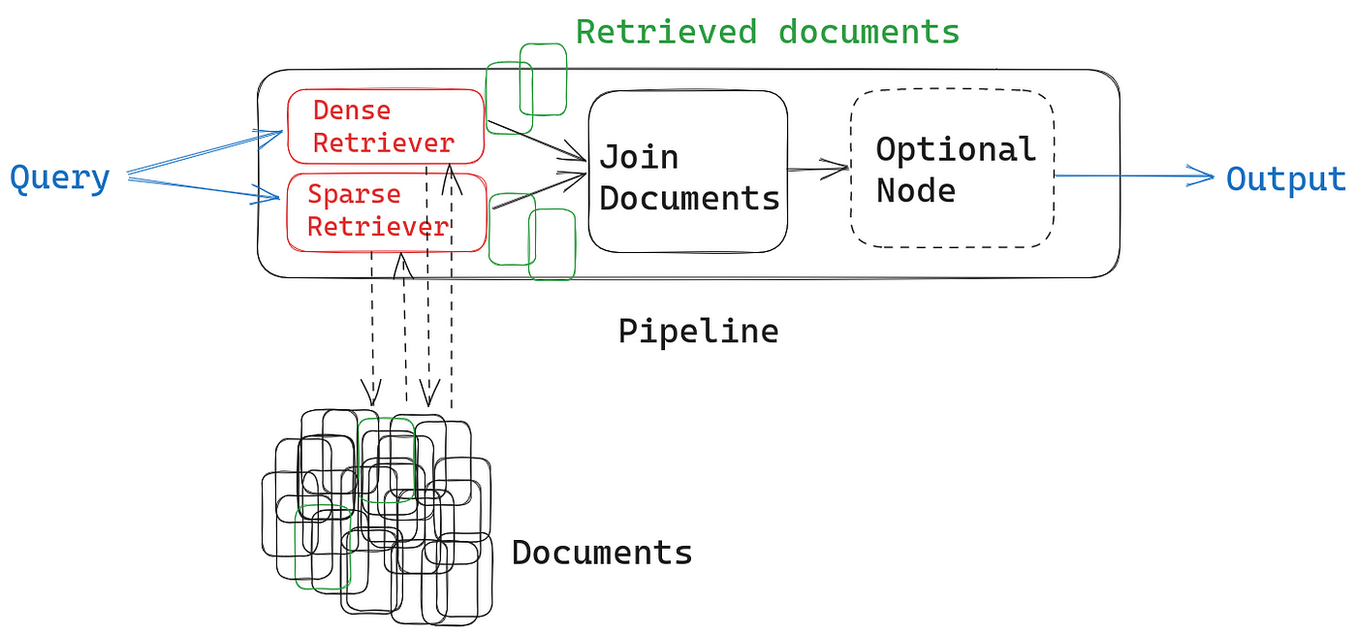
Retrieval-Augmented Generation (RAG)
Document Indexing (Retriever Setup)
Document Indexing (Retriever) is the process of preparing a collection of documents (e.g., Wikipedia articles, knowledge base entries, etc.) for fast and efficient retrieval in response to a user query. This is a key step in Retrieval-Augmented Generation (RAG) systems.
Document Indexing = Converting documents into dense vectors (embeddings) and storing them in a vector index (e.g., FAISS) to allow efficient similarity search.

Slide 41
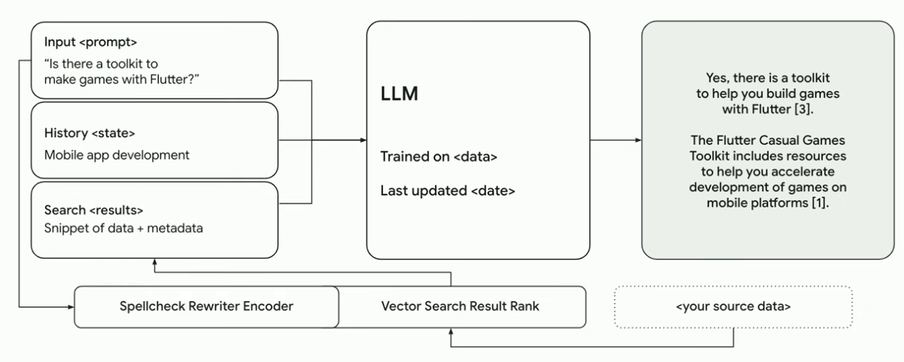
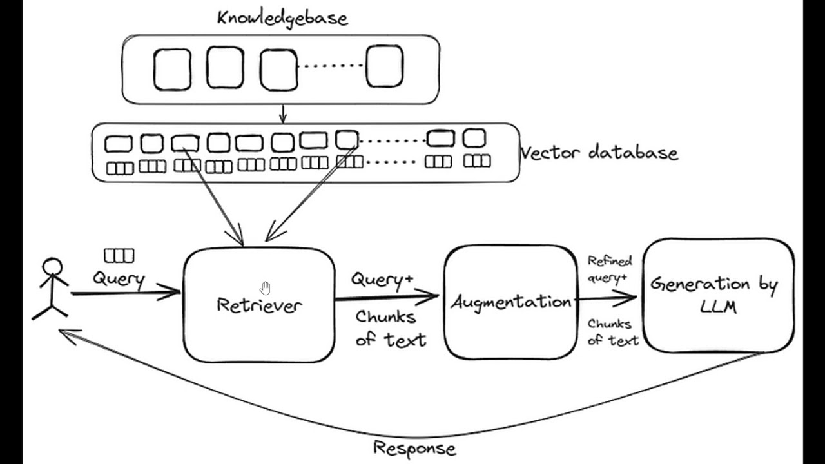
Retrieval-Augmented Generation (RAG)
RAG Pipeline (Retriever + Generator)

Slide 42
Retrieval-Augmented Generation (RAG)
Implementation of Retrieval-Augmented Generation (RAG)
Environment Setup
Prepare the Document Corpus
Embed Documents using Sentence Transformers
Create a FAISS Index
Define the Retrieval Function
Load a Generator Model (e.g., BART)
Ask a Question and Generate an Answer

Slide 43
Thank You

